Slide 1

GTA Real estate investment opportunities
Jonathan Densil

Slide 2
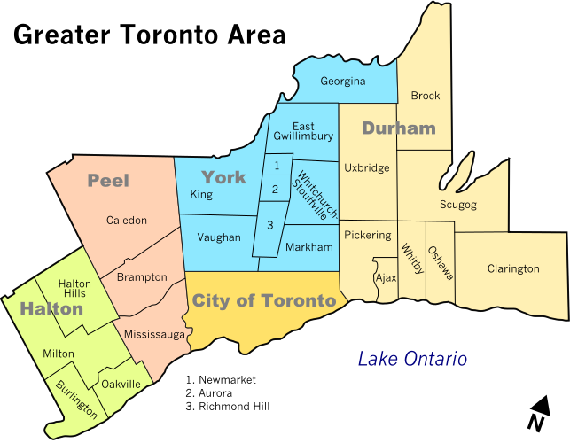
Why the GTA?
The GTA is the most populous metropolitan area
Houses around 20% of the population of Canada
Second-largest financial sector in North America.
Toronto is the 4th largest city in North America and Canada's business and financial capital.
Nearly 100,000 new immigrants annually
130 million people live within a 500-mile radius

Slide 3
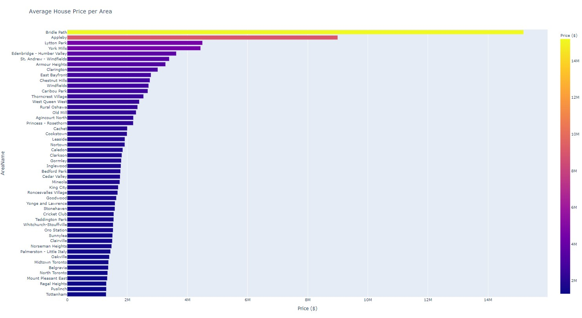

Slide 4
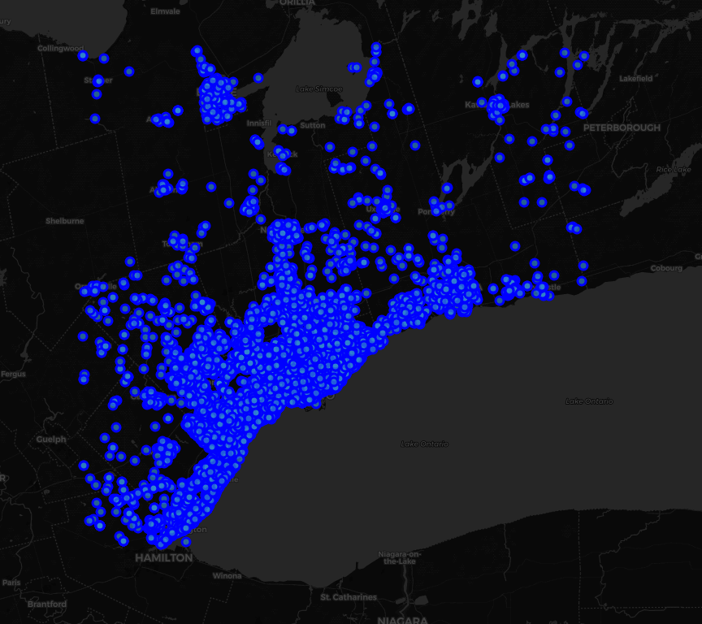
Location, location, location
Using machine learning algorithms, we can cluster the GTA into various segments to help predict the house of home given a certain location
Using k-means unsupervised machine learning, every point will be assigned a cluster, from which we can infer certain characteristics
Foursquare data will help guide the algorithm based on the most popular venues around each location

Slide 5
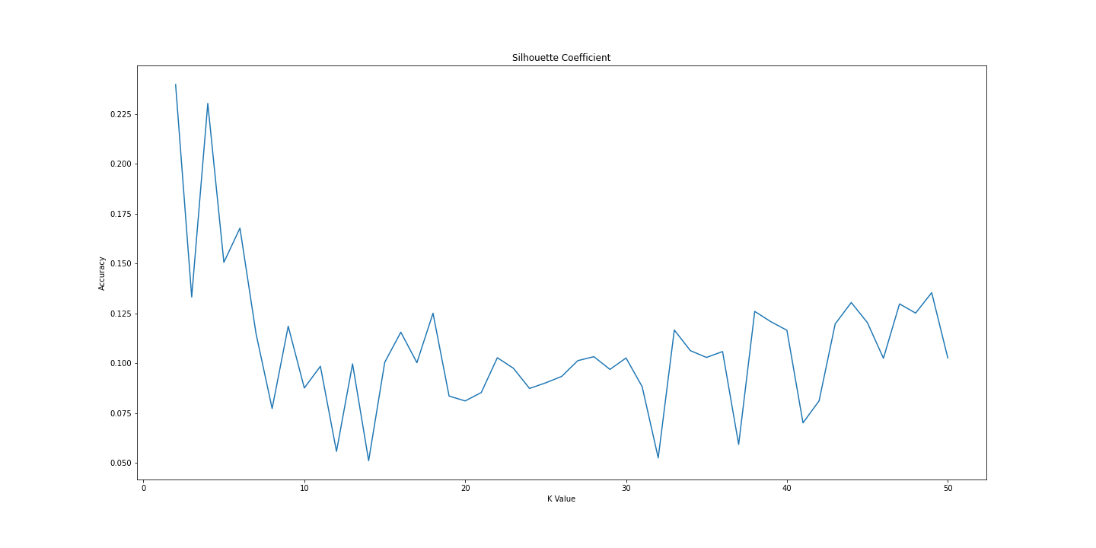
Silhouette Coefficient

Slide 6
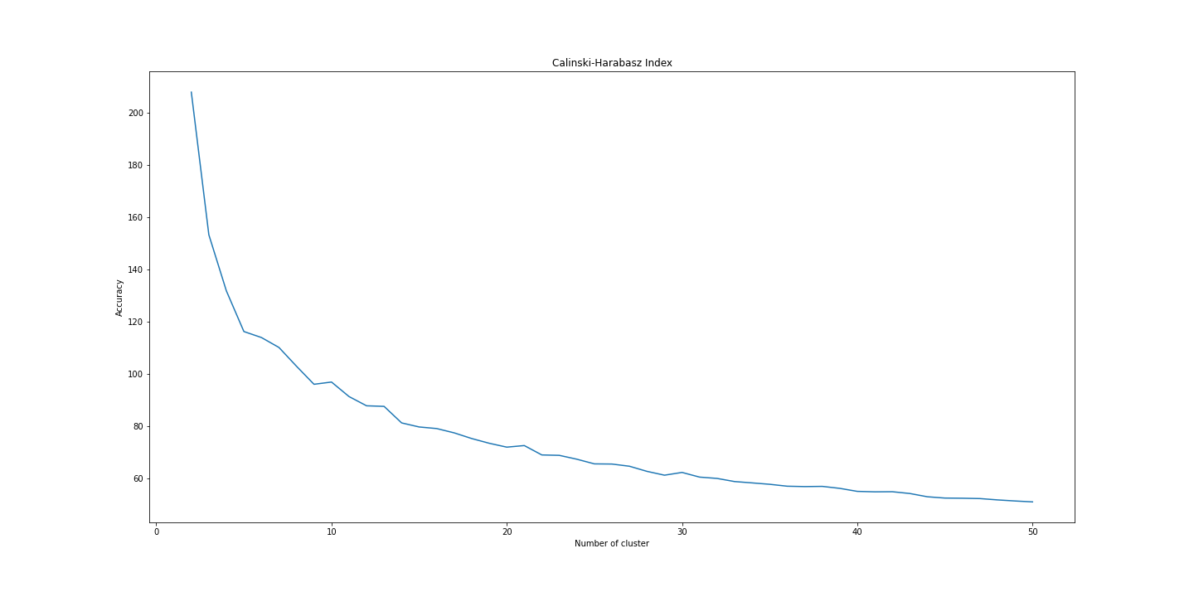
Calinski-Harabasz Index

Slide 7
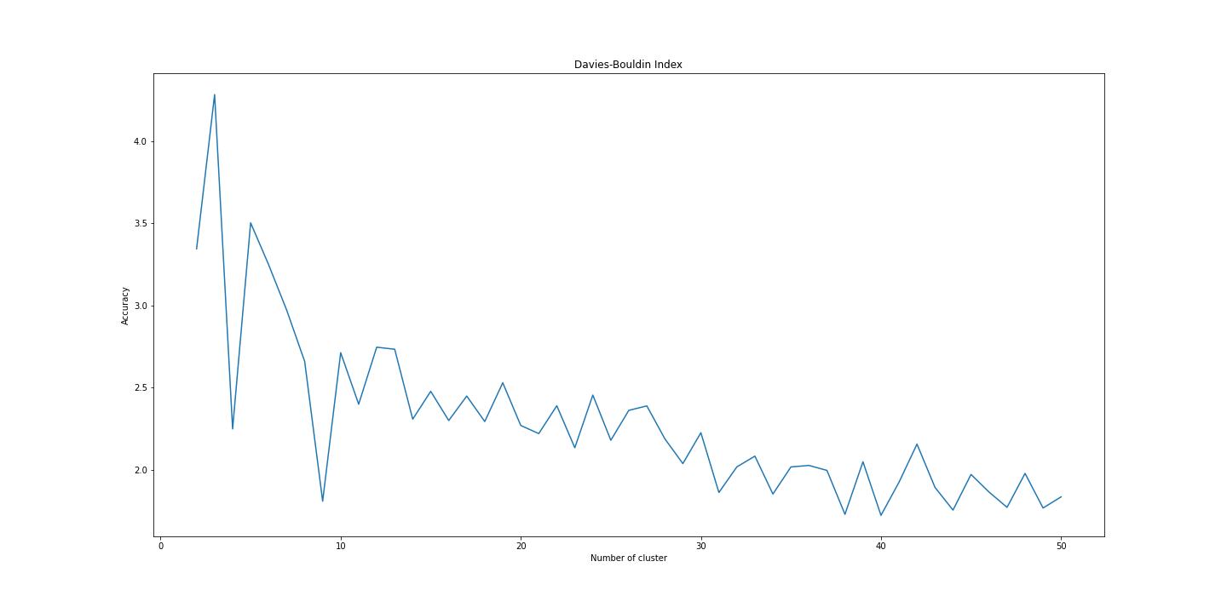
Davies-Bouldin Index

Slide 8
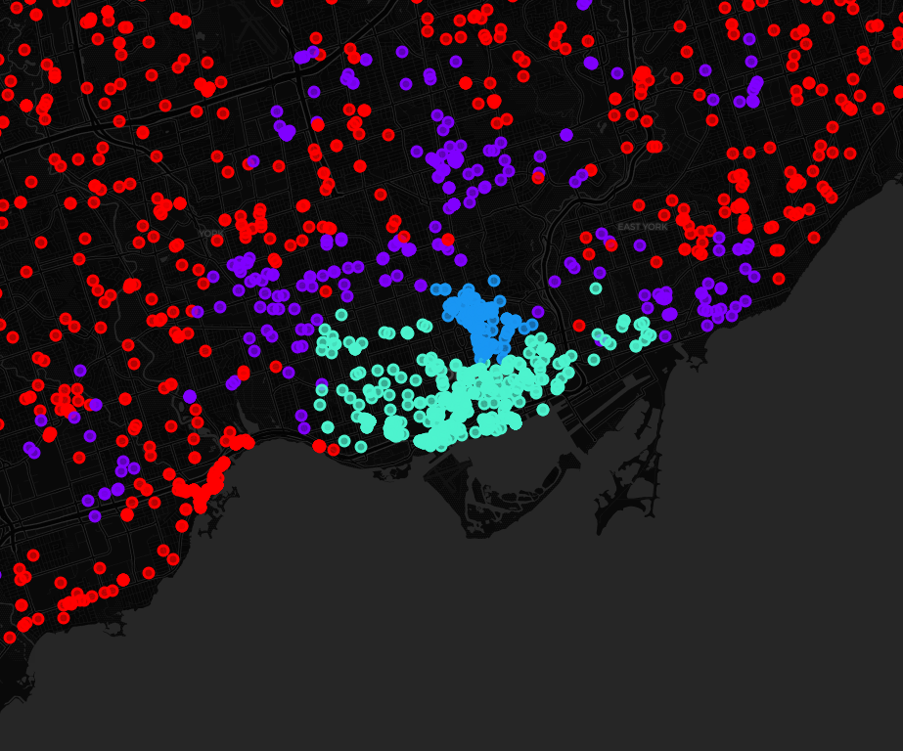
The Clustered GTA
Cluster 0 (red) can be categorised as upscale suburban housing due to having the highest average price and the scale at which it is spread across the suburbs of the GTA – avg. price = $927,429
Cluster 1 (purple) can be categorised as more affordable suburban housing since it has a lower average price in the suburbs and is not restricted to just downtown – avg. price = $675,705
Cluster 2 (blue) can be categorised as upscale downtown housing since it is concentrated primarily around the Yorkville and Rosedale neighbourhoods, two particularly affluent neighbourhoods in Toronto and the GTA – avg. price = $860,471
Cluster 3 (turquoise) can be categorised as more a ordable downtown housing due to it high concentration in the city of Toronto and having the lower average price – avg. price = $621,445

Slide 9

Where would you like to INVEST?
Jonathan Densil
jonathan.densil@gmail.com
(905) 399-6590
linkedin.com/in/jonathandensil/
github.com/JonathanDensil
IBM Data Science Professional Certificate
Coursera Inc.

